Slide 1
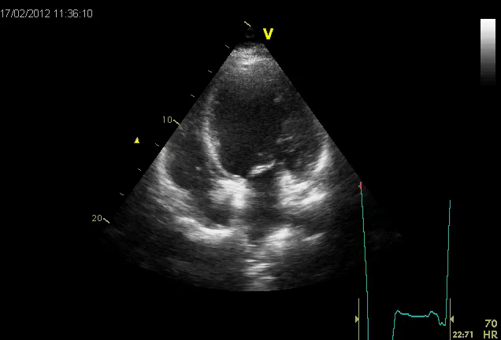
Notes:
Video 1 4 C pre-implante

