Slide 1
Table 3.0: Respondents Details
Frequency | Valid percentage (%) | Category | Demographic Variable
153 | 74.4 | Male | Gender
55 | 25.6 | Female
187 | 89.9 | Jordanian | Nationality
21 | 10.1 | Non-Jordanian
127 | 61.4 | Less than 25 years | Age
54 | 25.6 | 26-30 years
27 | 13.0 | 31-35Years and Above
77 | 36.8 | less than 5 Years | Experience
66 | 31.9 | 5 Yrs - 10 Yrs
45 | 20.9 | 11 Yrs - 15 Yrs
13 | 6.7 | 16 Yrs - 20 Yrs
7 | 3.7 | 21 Years and above
49 | 23.9 | High School | Education
63 | 29.9 | Bachelor
82 | 39.5 | Diploma
14 | 6.7 | Master

Slide 2
Table 3.1 Results of the measurement model for first order constructs
Construct | CR | Cronbach's Alpha | AVE
Employee Empowerment (EE) | 0.829 | 0.730 | 0.549
Employee perceived service quality (EPSQ) | 0.821 | 0.723 | 0.536
Job satisfaction (JS) | 0.852 | 0.769 | 0.592
Leadership Supportive behavior (LE) | 0.902 | 0.909 | 0.700
Work Environment (WE) | 0.863 | 0.788 | 0.614
Table 3.2 Discriminant Validity
Constructs | EE | EPSQ | JS | LE | WE
EE | 0.741
EPSQ | 0.395 | 0.732
JS | 0.512 | 0.494 | 0.769
LE | -0.145 | -0.135 | -0.137 | 0.836
WE | 0.518 | 0.440 | 0.502 | -0.093 | 0.783
Table 3.3: Heterotrait-Monotrait Ratio (HTMT)
Constructs | EE | EPSQ | JS | LE | WE
EE
EPSQ | 0.516
JS | 0.655 | 0.601
LE | 0.162 | 0.107 | 0.128
WE | 0.657 | 0.586 | 0.636 | 0.083

Slide 3
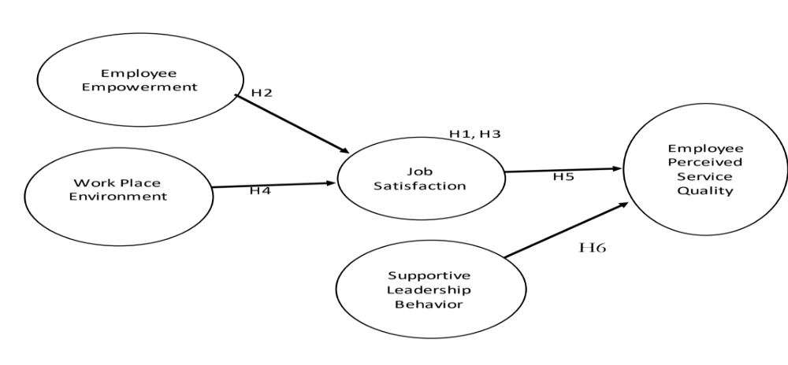
Table 3.4: Goodness of fit index
Variables |  | AVE | R² | Q²
Employee Empowerment (EE) |  | 0.549 | - | -
Employee perceived service quality (EPSQ) |  | 0.536 | 0.25 | 0.13
Job satisfaction (JS) |  | 0.592 | 0.33 | 0.19
Leadership Supportive behavior (LE) |  | 0.700 | - | -
Work Environment (WE) |  | 0.614 | - | -
Average Score |  | 0.59 | 0.11 | -
AVE X R² | 0.06
GoF=√(AVE ×R²) | 0.25
Figure 1: The Proposed structural model.

Slide 4
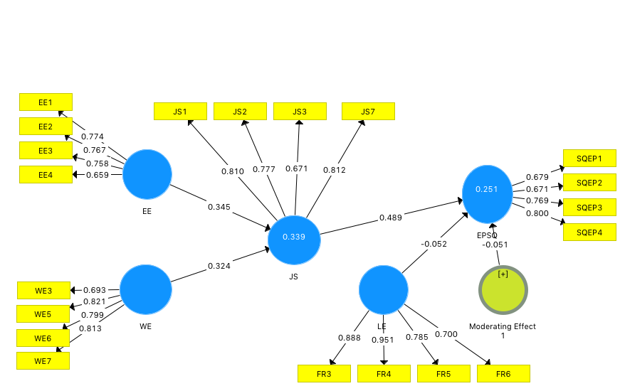
Figure 2: Measurement Model

Slide 5

Figure 3: Coefficient and P Values of variables.

